Slide 1
Jeff Zeng

Slide 2
2025 EOY Bonus

Slide 3
Bonus
Bonus Depends on company results & your results
2025 sales were down vs. 2024 and vs. our target.
However, we did a better job of managing our costs and improved our profitability.
Flyers can receive up to 100% of their bonus.
Your 2025 Bonus Potential
RMB 1,031 7 Months
Your 2025 Actual Bonus
RMB 2,088 1 Months 0% of Potential

Slide 4
2026

Slide 5
2026 Salary
Current Salary
RMB 3,012 Per month
2026 Salary
RMB 4,059 Per month
Merit Increase %
1 %
2026 Bonus Potential
RMB 5,085 5 Months

Slide 6
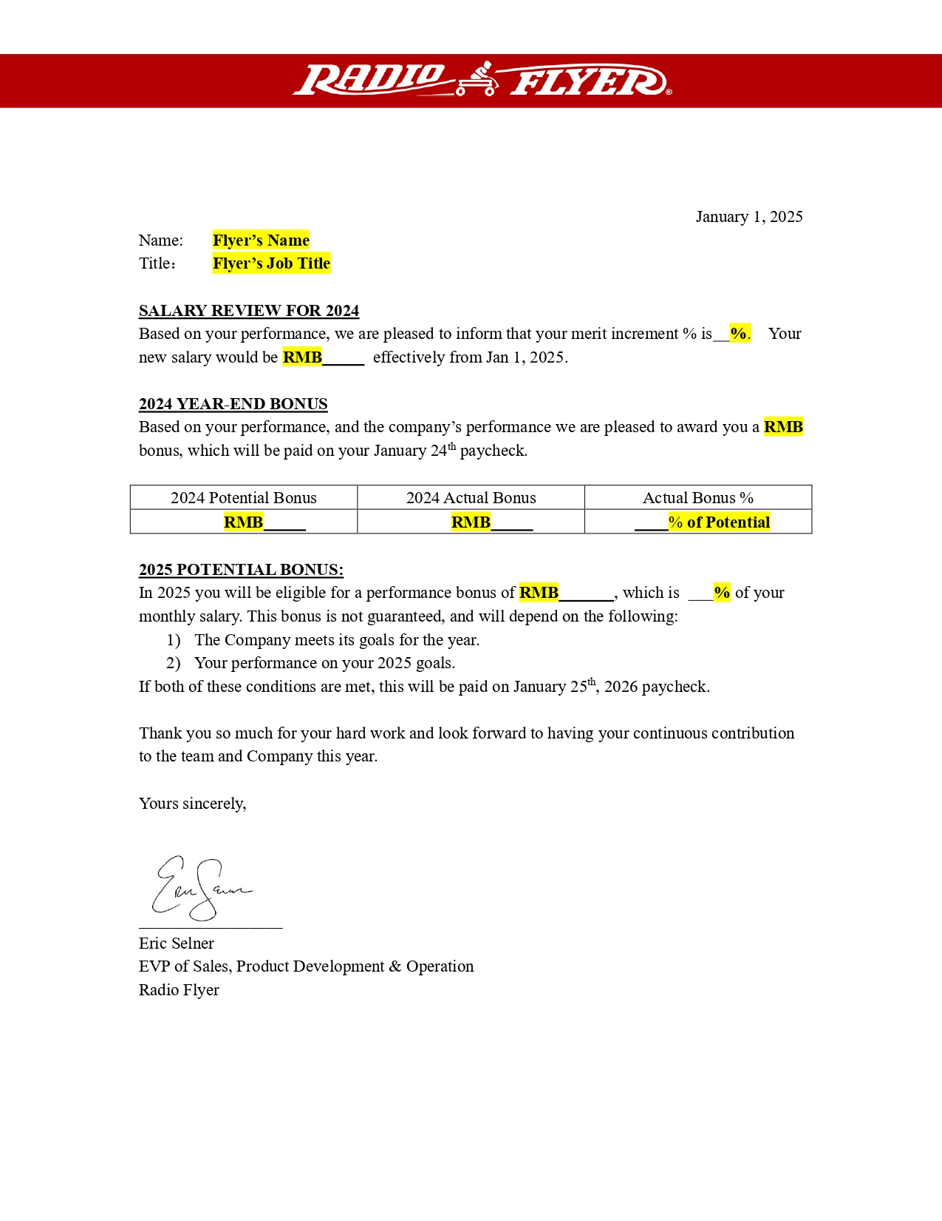
Image: Flyer’s salary letter

Slide 8
Tony Chen

Slide 9
2025 EOY Bonus

Slide 10
Bonus
Bonus Depends on company results & your results
2025 sales were down vs. 2024 and vs. our target.
However, we did a better job of managing our costs and improved our profitability.
Flyers can receive up to 100% of their bonus.
Your 2025 Bonus Potential
RMB 1,028 3 Months
Your 2025 Actual Bonus
RMB 2,095 9 Months 7% of Potential

Slide 11
2026

Slide 12
2026 Salary
Current Salary
RMB 3,064 Per month
2026 Salary
RMB 4,039 Per month
Merit Increase %
6 %
2026 Bonus Potential
RMB 5,094 6 Months

Slide 13
Image: Flyer’s salary letter

Slide 15
CK Liu

Slide 16
2025 EOY Bonus

Slide 17
Bonus
Bonus Depends on company results & your results
2025 sales were down vs. 2024 and vs. our target.
However, we did a better job of managing our costs and improved our profitability.
Flyers can receive up to 100% of their bonus.
Your 2025 Bonus Potential
RMB 1,006 9 Months
Your 2025 Actual Bonus
RMB 2,096 5 Months 2% of Potential

Slide 18
2026

Slide 19
2026 Salary
Current Salary
RMB 3,021 Per month
2026 Salary
RMB 4,077 Per month
Merit Increase %
4 %
2026 Bonus Potential
RMB 5,005 2 Months

Slide 20
Image: Flyer’s salary letter

Slide 22
Sea Liu

Slide 23
2025 EOY Bonus

Slide 24
Bonus
Bonus Depends on company results & your results
2025 sales were down vs. 2024 and vs. our target.
However, we did a better job of managing our costs and improved our profitability.
Flyers can receive up to 100% of their bonus.
Your 2025 Bonus Potential
RMB 1,009 4 Months
Your 2025 Actual Bonus
RMB 2,008 0 Months 7% of Potential

Slide 25
2026

Slide 26
2026 Salary
Current Salary
RMB 3,033 Per month
2026 Salary
RMB 4,099 Per month
Merit Increase %
4 %
2026 Bonus Potential
RMB 5,039 4 Months

Slide 27
Image: Flyer’s salary letter

Slide 29
Kyllo Chen

Slide 30
2025 EOY Bonus

Slide 31
Bonus
Bonus Depends on company results & your results
2025 sales were down vs. 2024 and vs. our target.
However, we did a better job of managing our costs and improved our profitability.
Flyers can receive up to 100% of their bonus.
Your 2025 Bonus Potential
RMB 1,044 2 Months
Your 2025 Actual Bonus
RMB 2,041 4 Months 8% of Potential

Slide 32
2026

Slide 33
2026 Salary
Current Salary
RMB 3,013 Per month
2026 Salary
RMB 4,075 Per month
Merit Increase %
1 %
2026 Bonus Potential
RMB 5,039 6 Months

Slide 34
Image: Flyer’s salary letter

Slide 36
Celia Cai

Slide 37
2025 EOY Bonus

Slide 38
Bonus
Bonus Depends on company results & your results
2025 sales were down vs. 2024 and vs. our target.
However, we did a better job of managing our costs and improved our profitability.
Flyers can receive up to 100% of their bonus.
Your 2025 Bonus Potential
RMB 1,006 8 Months
Your 2025 Actual Bonus
RMB 2,037 4 Months 5% of Potential

Slide 39
2026

Slide 40
2026 Salary
Current Salary
RMB 3,043 Per month
2026 Salary
RMB 4,077 Per month
Merit Increase %
0 %
2026 Bonus Potential
RMB 5,031 3 Months

Slide 41
Image: Flyer’s salary letter

Slide 43
James Xia

Slide 44
2025 EOY Bonus

Slide 45
Bonus
Bonus Depends on company results & your results
2025 sales were down vs. 2024 and vs. our target.
However, we did a better job of managing our costs and improved our profitability.
Flyers can receive up to 100% of their bonus.
Your 2025 Bonus Potential
RMB 1,076 9 Months
Your 2025 Actual Bonus
RMB 2,005 7 Months 6% of Potential

Slide 46
2026

Slide 47
2026 Salary
Current Salary
RMB 3,016 Per month
2026 Salary
RMB 4,080 Per month
Merit Increase %
8 %
2026 Bonus Potential
RMB 5,014 4 Months

Slide 48
Image: Flyer’s salary letter

